Slide 1
MVC Introduction

Slide 2
Design Patterns ASP.NET
Design patterns are solutions to software design problems you find again and again in real-world application development.
Patterns are about reusable designs and interactions of objects..
There are 23 Gang of Four (GoF) patterns
The 23 Gang of Four (GoF) patterns are generally considered the foundation for all other patterns. They are categorized in three groups:
Creational,
Structural, and
Behavioral

Slide 3
ASP.NET MVC
Asp.net MVC framework built on top of Microsoft .NET framework
Open source framework
clean code separation
It is most customizable and extensible framework provided by Microsoft
It is web development framework from Microsoft which is base on MVC(Model View Controller) architectural design pattern

Slide 4
Core component of MVC
Models:
C# classes
Represent the data And business logic of the application
Responsible for accessing & storing data & associated logic
Use validation logic
View:
Handles representation layer of the application
It uses razor view engine to embed .NET code with HTML
Responsible for displaying application’s user interface
Controller:
Nothing but C# classes
act as an intermediary between the Model and View
processes incoming requests manipulates data using model & renders the final output to the view
Handles request to the applications by the user
Get data from database or objects
Specify the view that return a response to the client

Slide 5
WCF
Service
Browser
Look & data
always
Model
Data Layer
Controller
If required
Co-ordinator
Some time
View
Look & Feel

Slide 6
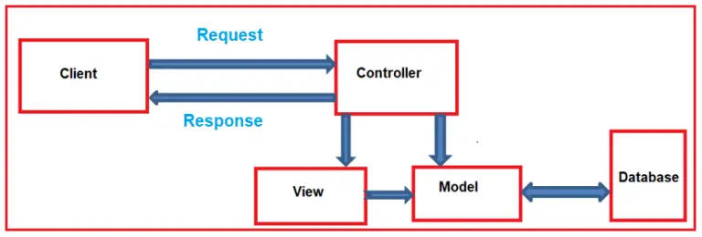

Slide 7
Action Method
Controller : C# class that
Handles request to the application by the user
Get data from database Or objects
Specify view that return a response to the client
These tasks are done by Controller’s Action Methods.

Slide 8
Action Methods
Action Methods:
Action methods are public methods in Controller classes.
By default it generates a response in the form of ActionResult
Restrictions:
Action method must be public. It cannot be private or protected.
Action method cannot be a static method

Slide 9
ActionLink
ActionLinks are used to connect one Action’s view to another
General Syntax:
@Html.ActionLink(“LinkText”,”ACTIONNAME”,”CONTROLLERNAME”)
for Example
@Html.ActionLink(“Contact Us”,”ContactUs”,”Home”)

Slide 10
Razor View Engine
Views:
These are screens which users see as response they request information from controllers
views are usually made from HTML and C# code.
Razor Engine helps views to mix HTML and C# code
razor views has file extension .cshtml

Slide 11
inline expression (e.g. @DateTime.Now.ToShortDateString() )
variables using var statement
multi-statement code block (e.g. @{ }
if-else condition code block
for loop code block
foreach loop code block

